Slide 1
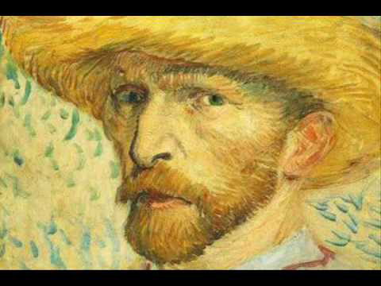
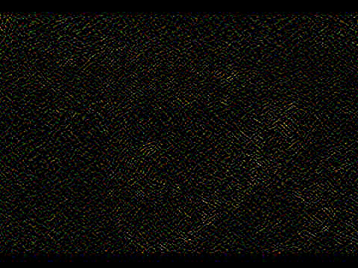


Singular Value Decomposition (SVD)
… and Image Compression!
By Samuel Desrosiers

Slide 2
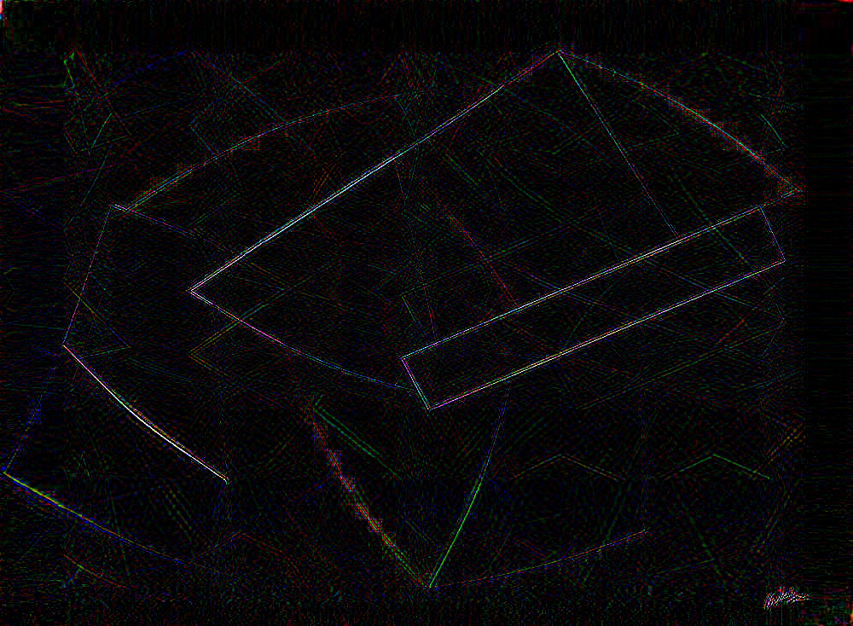
What to see?
Back to the SVD
General idea
Low rank approximation
General applications
Images and entropy
Compression with low rank
B&W
RGB
… about what we lost!

Slide 3
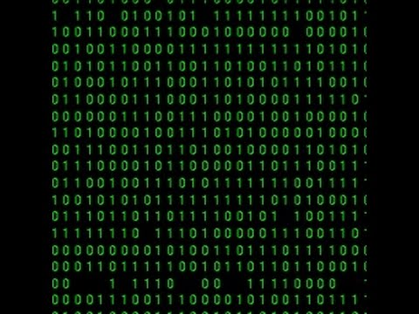
Back to the SVD
Generalization of eigenvalue decomp.
…and more
The Singular Value Decomposition is basically the eigenvalue decomposition for non-square matrices.
It can be used to find the rank of a matrix. You can write the SVD as a product of three matrices!
Let’s see…

Slide 4
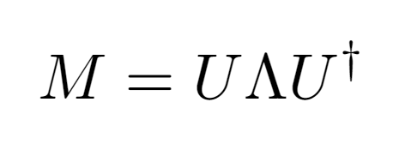
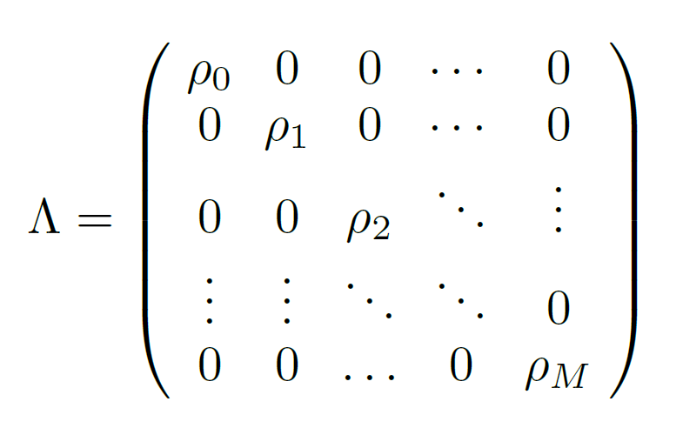
Back to the SVD
Eigenvalue decomposition

Slide 5
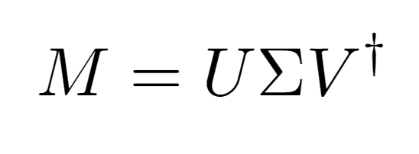
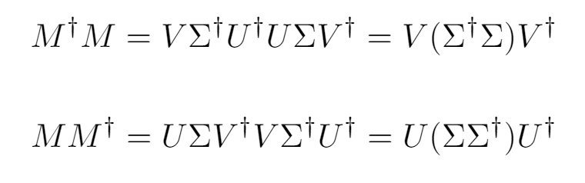
Back to the SVD
The SVD
Strictly positive, in order of size
D

Slide 6
Back to the SVD
Low rank approximation
D

Slide 7
Back to the SVD
Low rank approximation
All amazing!
Can be used in practice:
Principal component analysis
Tensor networks (To be seen later !!!)
Many more…
…including… image compression
WOW!

Slide 8
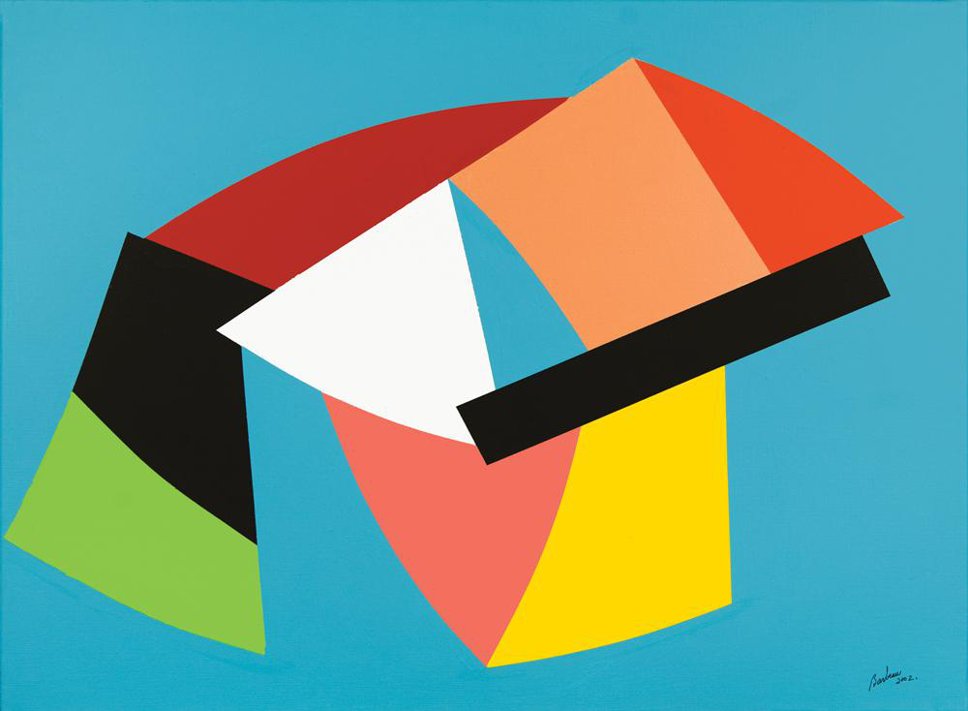
Images and compression
Images are matrices…
…see where we are going?
As images are basically matrices. We can use SVD on them to compress them.
How much? Does the specific image matters?

Slide 9
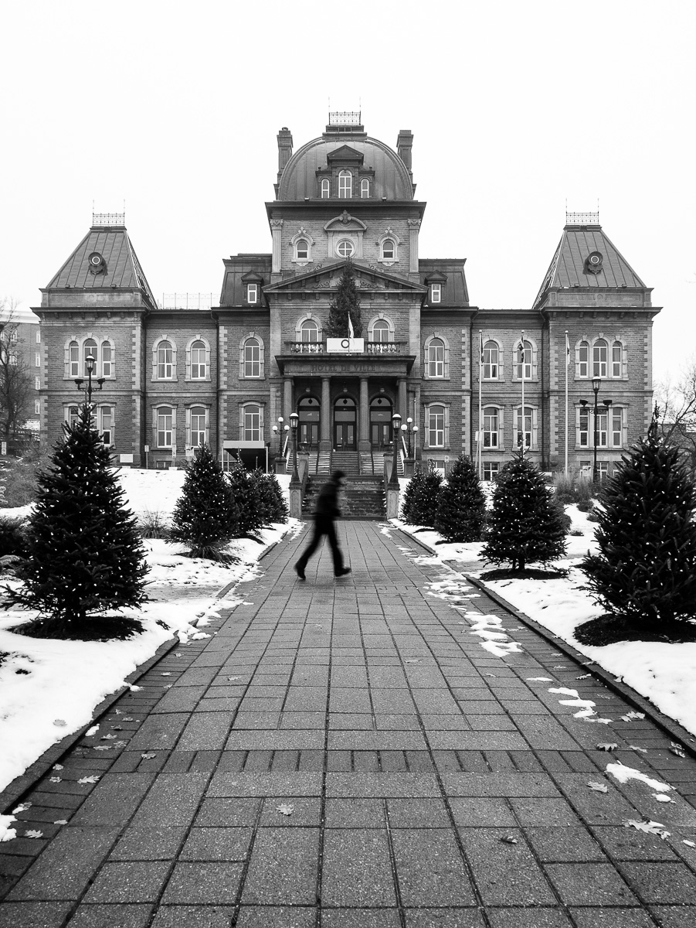
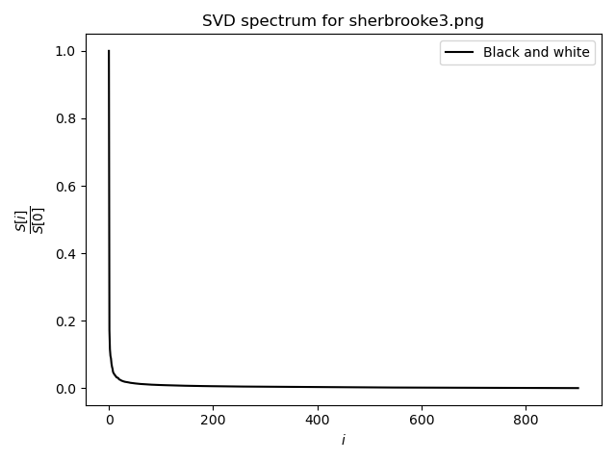
Images and Entropy
Remember!

Slide 10
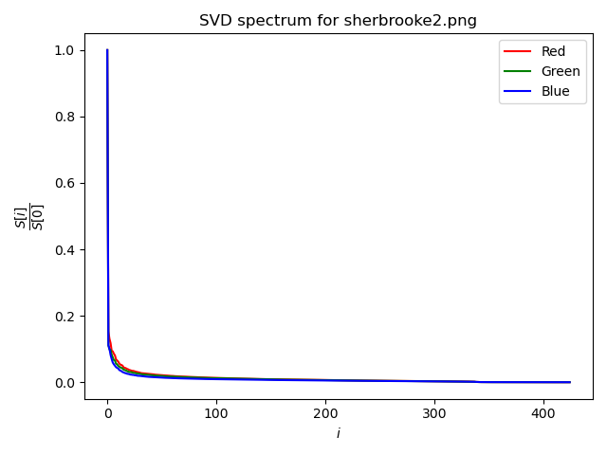
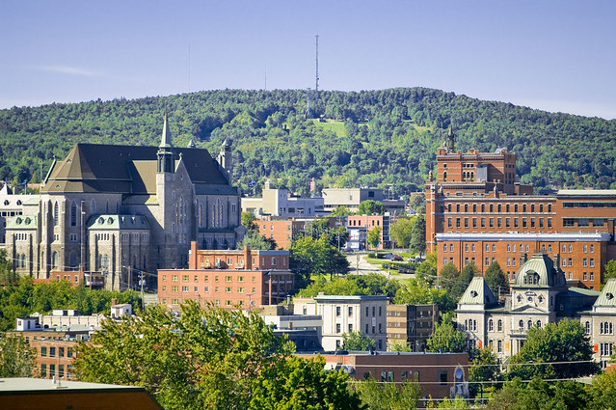
Images and Entropy
We now do it for 3 matrices (RGB)
Remember!
Insignificant values

Slide 11
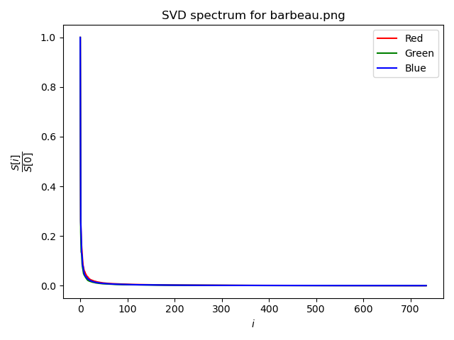
Images and Entropy
Let’s do it with art… Too very different paintings!

Slide 12
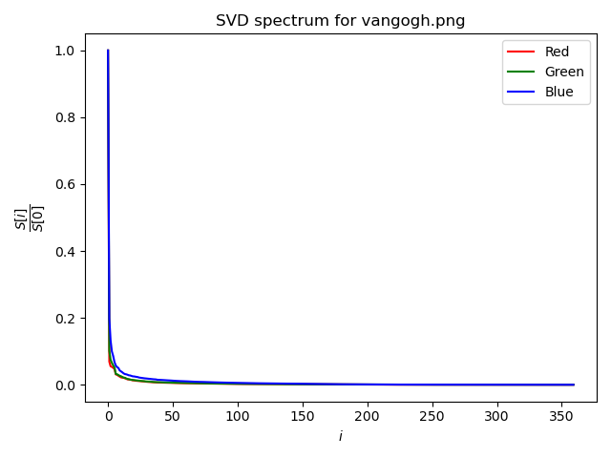
Images and Entropy
We can observe differences in spectra for each color. Link to disordering and entropy!

Slide 13
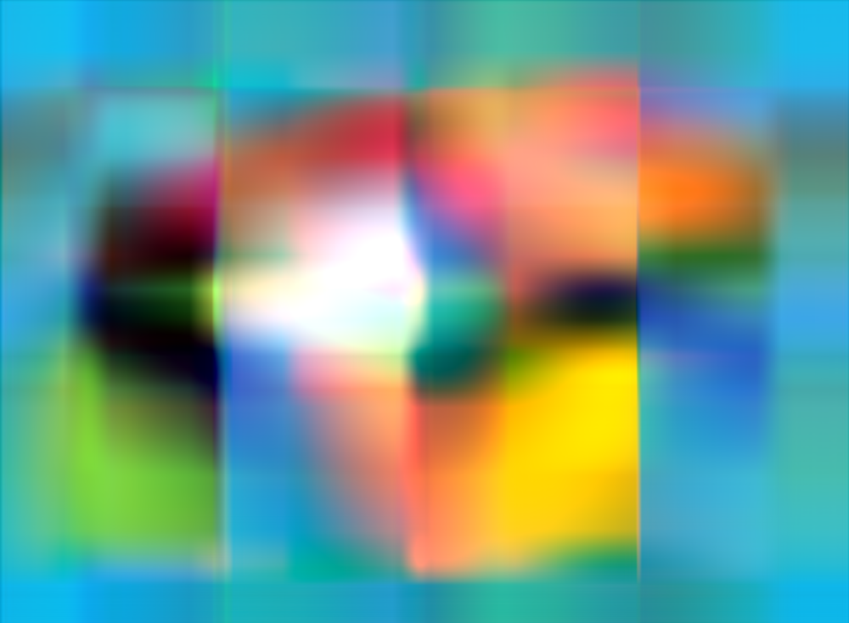
Compression
Well… is it any good?

Slide 14

Images and Entropy
Compression
It can be quite efficient!
Original size in floats:
1081200
New size in floats:
U=211200
S=176
V=158576
Tot.=369952
Approx. Comp. Rate:
Orig. size
2.92
New. size

Slide 15
Curiosity and Analysis
… About what we lost!
Here we can see what are the details that we lost by only keeping the SVD values that we cut earlier!

Slide 16
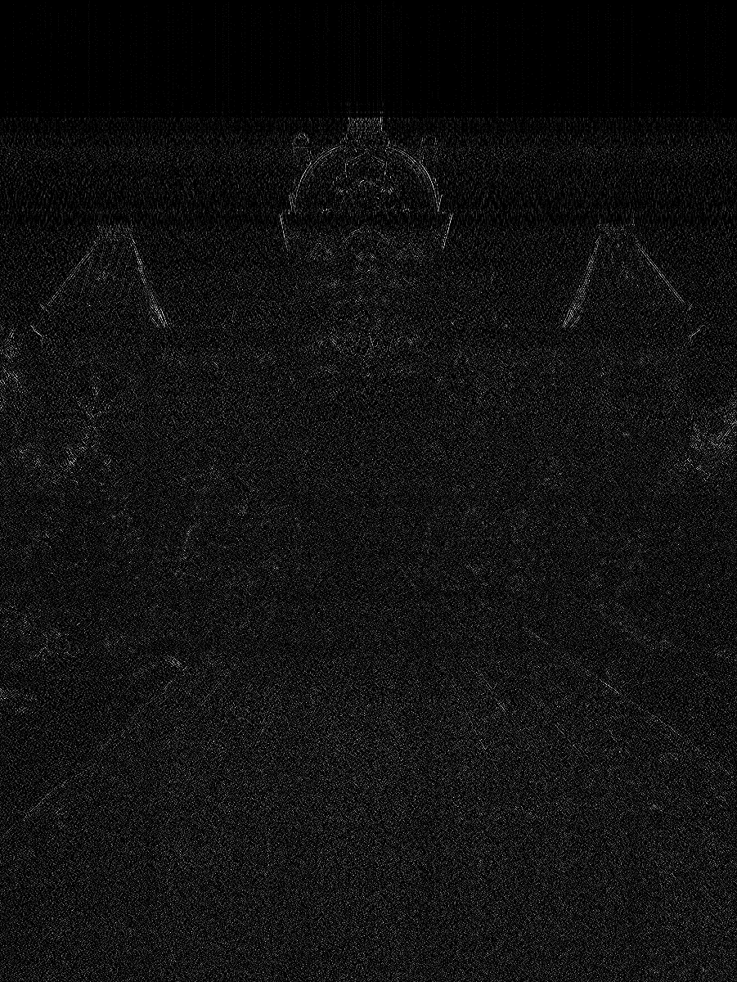
Curiosity and Analysis

Slide 17
Curiosity and Analysis

Slide 18
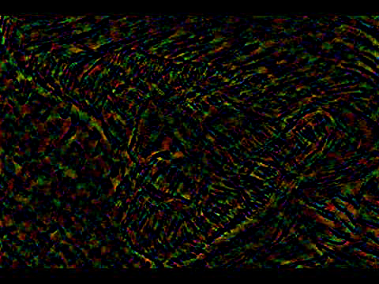
Curiosity and Analysis

Slide 19

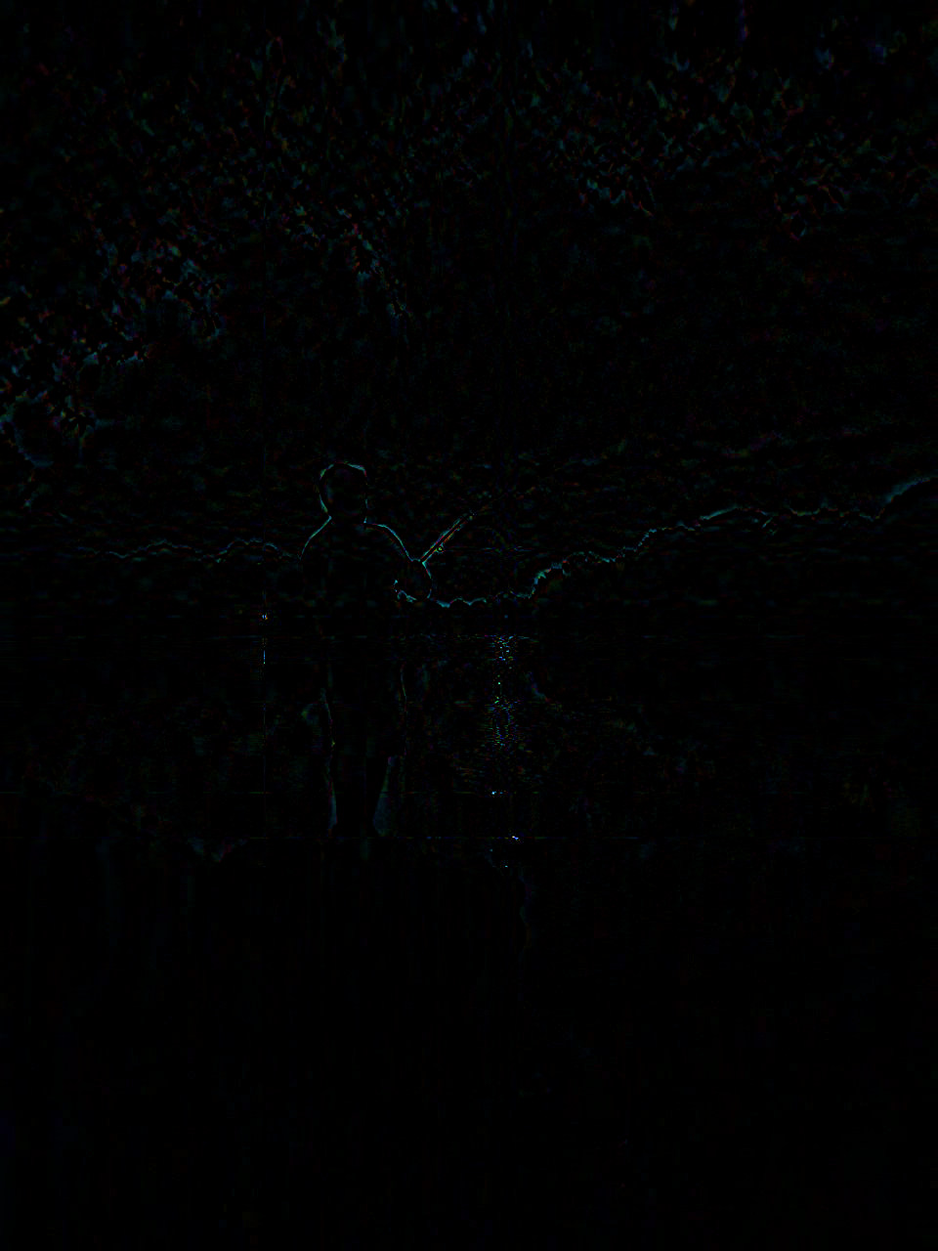
Curiosity and Analysis
If you want know more…

